Slide 1


Welcome to C Programming
This presentation will introduce you to C, a powerful and widely used programming language.
by Istiak Rahman

Slide 2
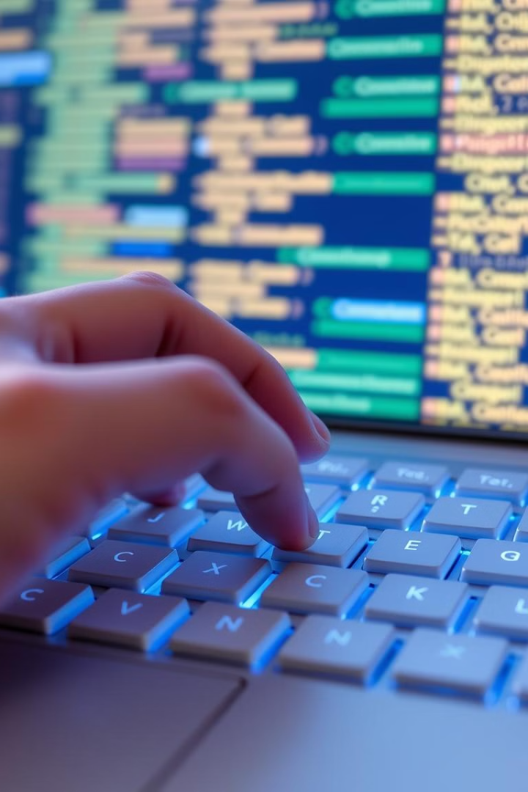
Overview of C Programming
1
What is C?
2
Importance & History
3
Applications of C
4
Basic Structure

Slide 3
Translators: Assembler, Compiler, Interpreter
Assembler
Compiler
Interpreter

Slide 4
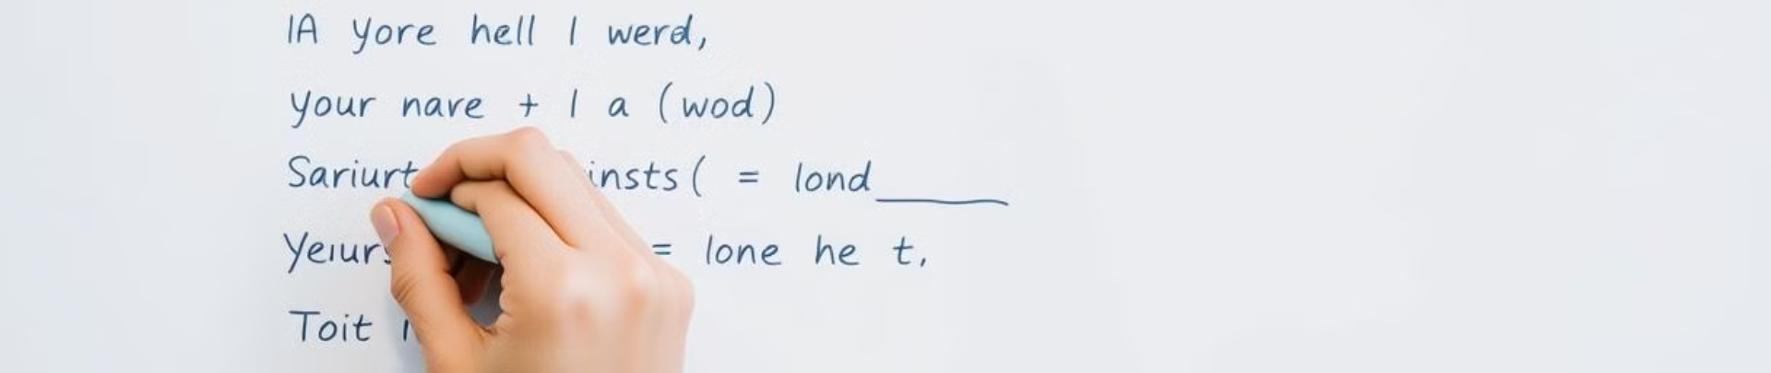
Variables, Constants & Keywords
Variables
Constants
Keywords
Data Types

Slide 5
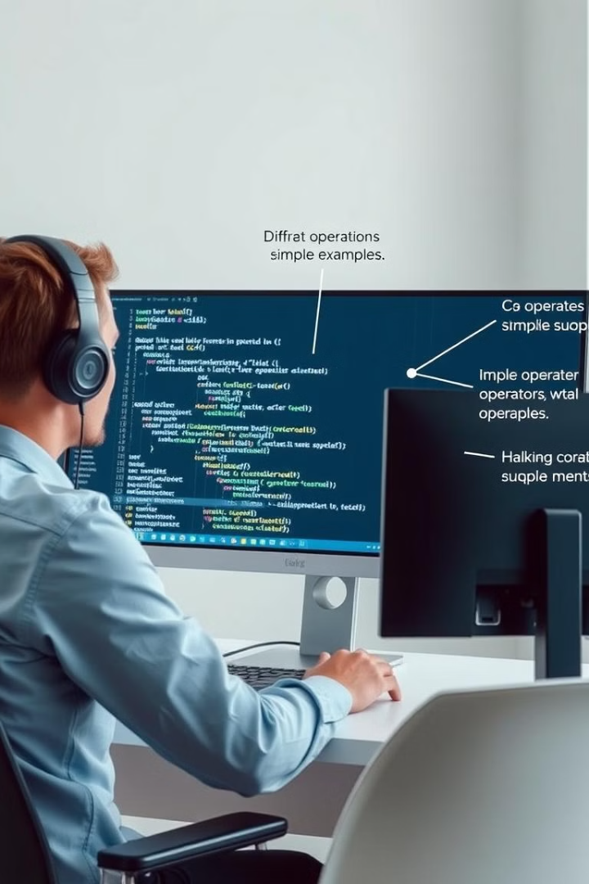
Instructions and Operators
Arithmetic
+, -, \*, /, %
Relational
==, !=, >, <
Logical
&&, ||, !
Assignment
=, +=, -=

Slide 6
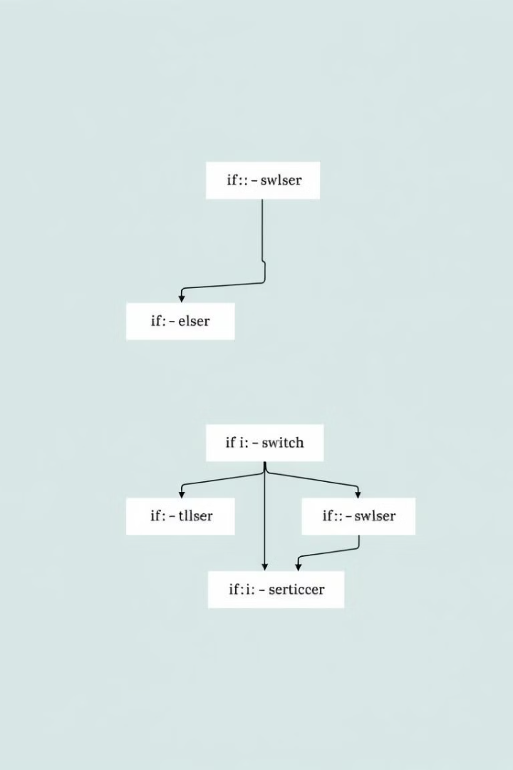
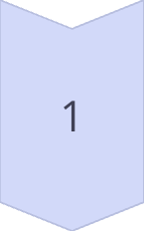
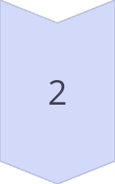
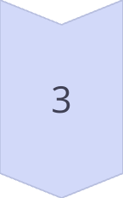
Conditional Instructions (Decision Making)
If Statement
Executes code based on a condition.
If-Else Statement
Provides an alternative code block if the condition is false.
Nested If-Else
Allows for multiple conditions to be checked.

Slide 7





Loop Control Instructions
For Loop
While Loop
Do-While Loop
Break & Continue
Executes a block of code a specified number of times.
Repeats a block of code as long as a condition is true.
Executes a block of code at least once, then repeats based on a condition.
Used to control the flow of loops, exiting or skipping iterations.

Slide 8
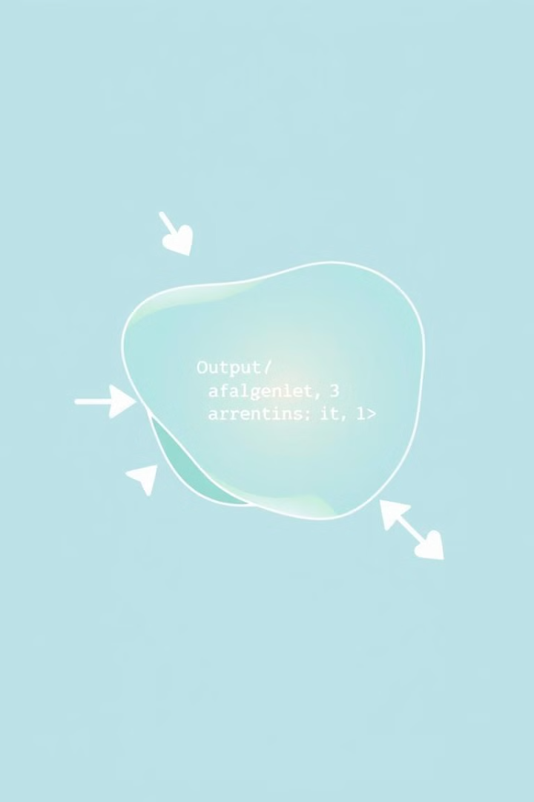
Functions
1
Defining and Using Functions
Functions are reusable blocks of code that perform specific tasks.
2
Types of Functions
Functions can return a value or perform actions without returning a value.

Slide 9
Arrays in C

Slide 10
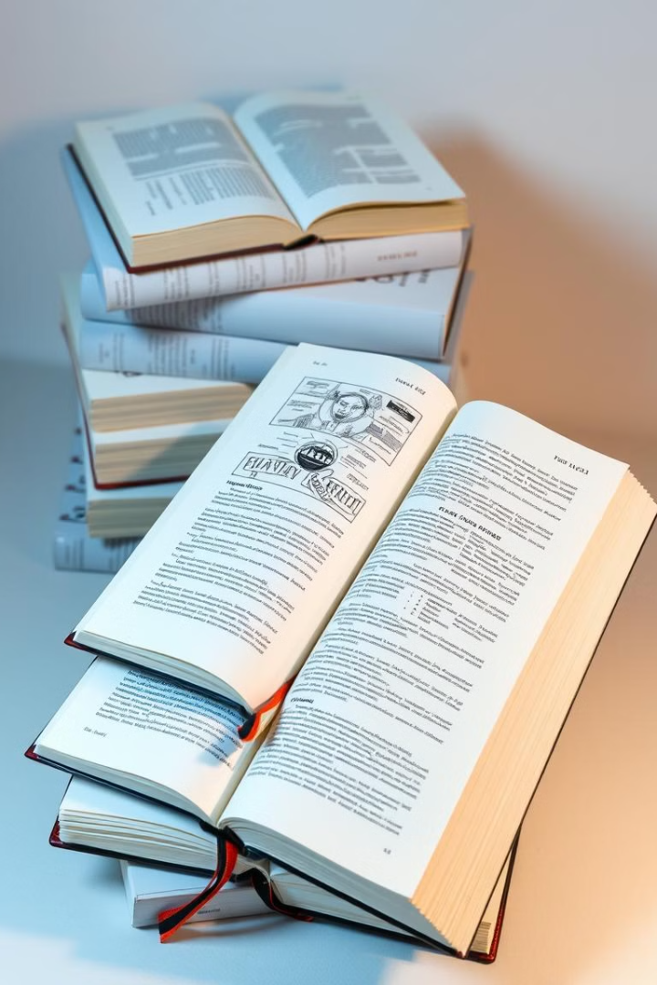
Solving Text Book Problems

Slide 11

Introduction to Programming and C Language
Welcome to the world of programming! This course will guide you through the fundamentals of programming, starting with the C language. We'll explore what programming is, why it's important, and how it works.
by Istiak Rahman

Slide 12
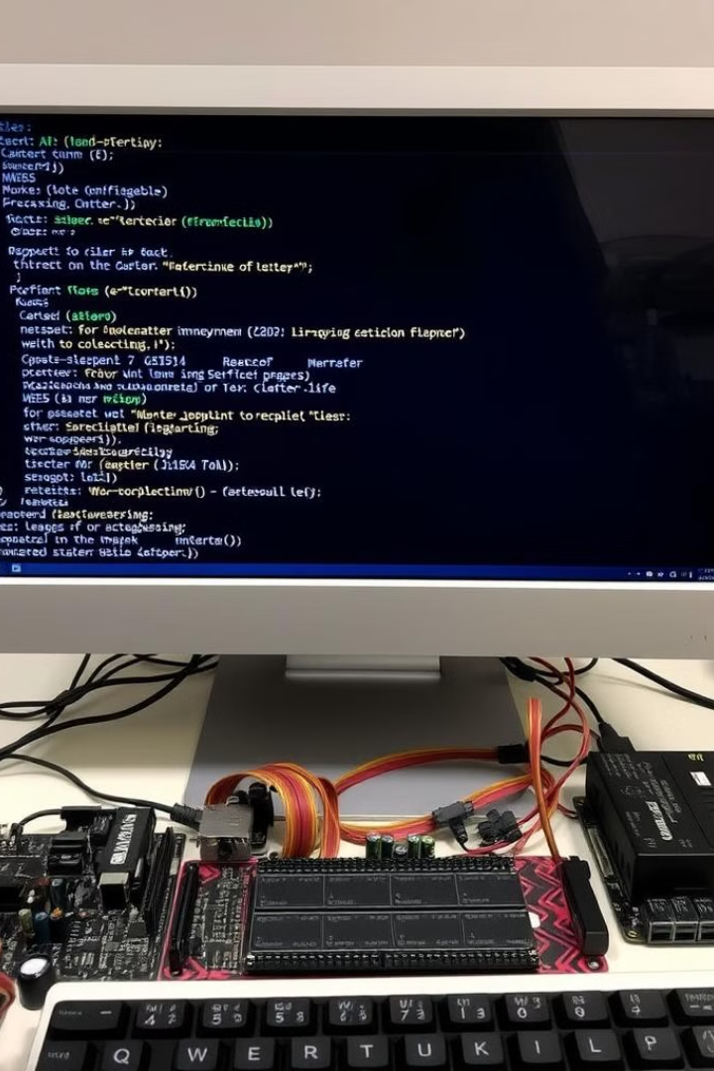
What is Programming?
Giving Instructions
Programming involves creating instructions for computers to follow.
Solving Problems
Programs are designed to solve specific tasks and automate processes.
Efficiency and Automation
Programs can perform complex calculations and actions much faster than humans.

Slide 13
Types of Programming Languages
High-Level Languages
Low-Level Languages
Closer to human language and easier to understand.
Closer to machine code and more complex.
C
Assembly
Python
Machine Language
Java

Slide 14
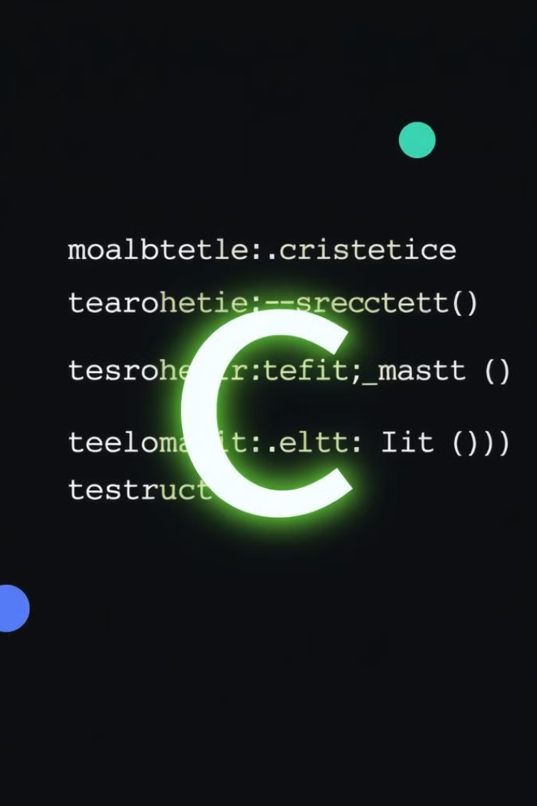
Introduction to C Language
1
General-Purpose
C can be used for a wide variety of applications.
2
Procedural Programming
Programs are structured as a sequence of instructions.
3
Efficient and Powerful
C is known for its speed and ability to interact directly with hardware.
4
Influential
C has influenced many modern programming languages.

Slide 15
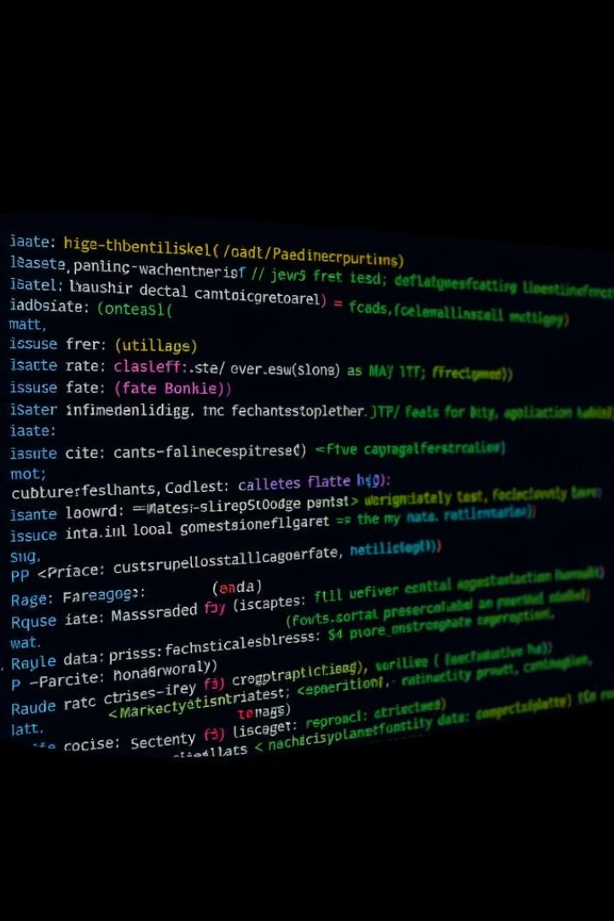

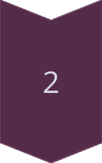
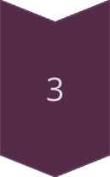
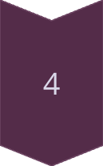
Features of C Programming
Simplicity and Efficiency
C has a clean syntax and produces efficient machine code.
Structured Programming
Large programs are broken down into smaller, manageable functions and modules.
Portability
C programs can run on different systems with minimal modifications.
Low-Level Access
C allows for direct memory manipulation with pointers.

Slide 16

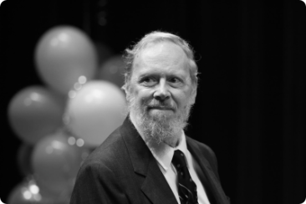
History and Importance of C
1972
1
C, programming language developed by Dennis M. Ritchie at Bell Laboratories
2
System Software
C was initially used for creating operating systems like Unix.
Influential Language
3
C inspired the development of other languages like C++, Java, and Python.
4
Modern Applications
C remains essential for systems programming, embedded systems, and performance-critical applications.

Slide 17

Thank You!
Presented by: Istiak Rahman Email: istiak.rahman1020@gmail.com Thank you for your attention! I appreciate your time and interest.
Keep Learning, Keep Growing

